Slide 1
VISUALIZATION USING MATPLOTLIB WITH DIFFERENT TYPES OF PLOTS

Slide 2
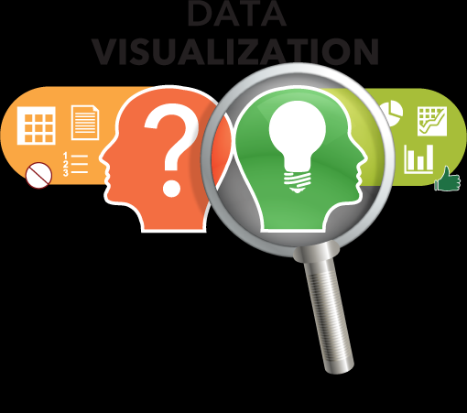
Why data visualization?
Human brain can process information easily when it is in pictorial or graphical form.

Slide 3

Data visualization allows us to quickly interpret the data and adjust different variables to see their effect.

Slide 4
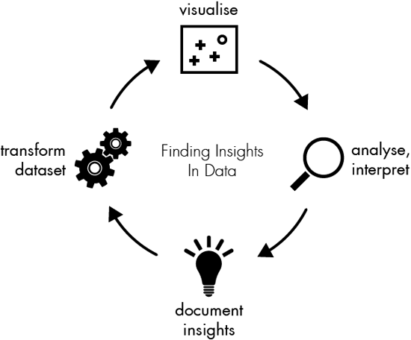
Data visualization is the presentation of data in a pictorial and graphical format.

Slide 5
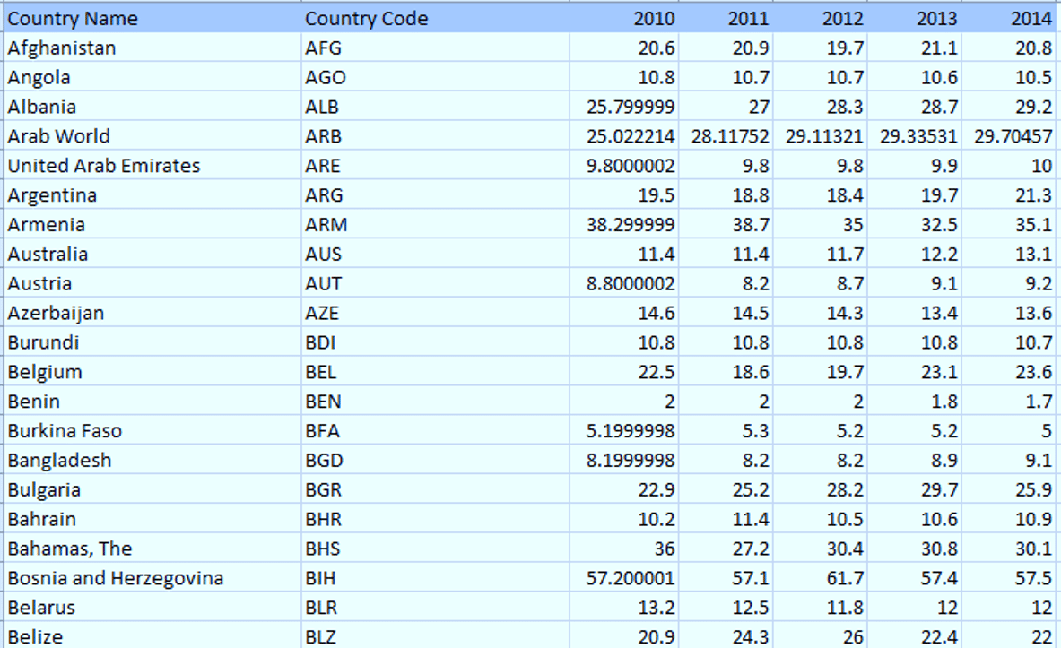
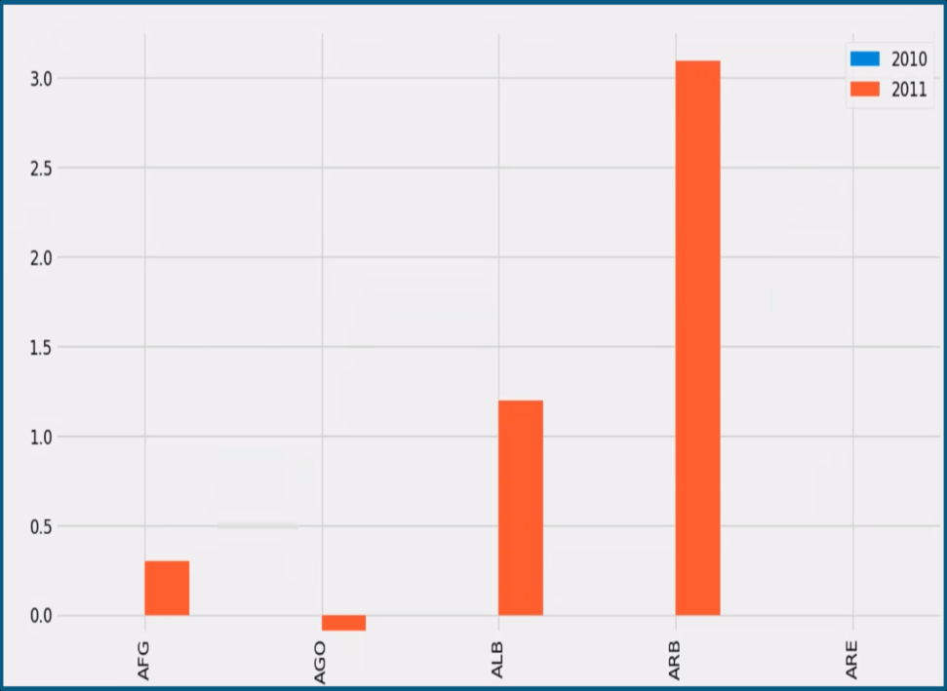
What is Matplotlib? Matplotlib is a Python package use for 2D graphics.

Slide 6
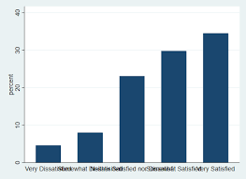
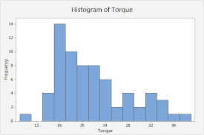
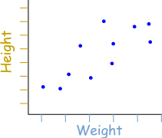
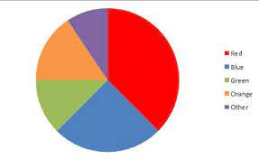
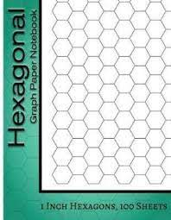
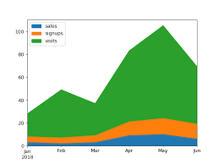
Types of Plots
Bar Graph
Histograms
Scatter Plot
Pie Plot
Area Plot
Hexgonal Bin Plot

